Slide 1
ETFS Governance
3M executive summary

Slide 2
What is Governance
From the Microsoft.com
Governance is the set of policies, roles, responsibilities, and processes that control how an organization's business divisions and IT teams work together to achieve its goals. Every organization has unique needs and goals that influence its approach to governance. Larger organizations will probably require more—and more detailed—governance than smaller organizations.
A good governance plan can: Streamline the deployment of products and Technologies, Help keep you organization’s system secure and compliant, and Help ensure the best return on your investment in technology.

Slide 3
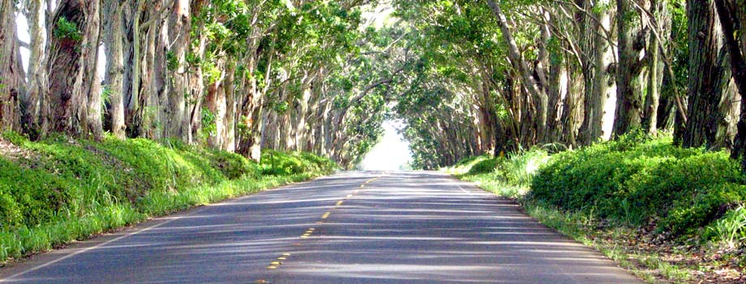
What is Governance to Users
Governance is like driving on a road
You have certain rules that must be followed
Speed limits
Which lane to drive in
Type of vehicles on certain roads
Passing exams and tests to drive on the road
Other governance rules are guidelines where users assumes certain risks
Driving slower when it is raining
Choosing which road to use to get to your destination
Choosing the vehicle to use on the road
Choosing when to drive on the road

Slide 4
3M Today
3M has many project teams using different application lifecycle management processes.
Each project team or division controls and does what it wants for branching and application lifecycle management process
Support for many different processes is not feasible

Slide 5
Current Risks to 3M and Project Teams
Due to non-centralized ALM processes, the following risks could occur to project teams and to the company
Auditing can be Inconsistent
No centralized Executive reporting
No ability to audit tools or open source licensing
Inconsistent software development processes
Inconsistent Software Quality Assurance
Limited Resource Portability
Inconsistent Security policies

Slide 6
Governance Summary
Common Security with Active Directory
Consistent processes for onboarding project teams
Consistent process templates and providing a process for getting beneficial changes into the templates for all project teams
Consistent branching and merging
Change board manages changes to the Enterprise Team Foundation Server
Defines controls for support costs and the effort for the Enterprise Team Foundation Server environment
Establish Development Tools Administration (DTA) – Virtual Interest Group

Slide 7
Benefits
Controlled Security and creation of Team Projects (Project Teams, DTA)
Common set of Application Lifecycle Management processes for CMMI, Agile and Scrum (Project Teams, DTA)
Change board to control and manage changes to the Enterprise Team Foundation Server environment (3M, Project Teams, DTA)
Consistent audit of applications (3M, Project Teams)
Centralized and standardized environment provides for future automation and reporting (3M, DTA)
Reduced support and maintenance cost of source control and Application Lifecycle Management (3M, DTA)
Using modern tools reduce support needs and costs (Project Teams, DTA)

Slide 8
Governance Process Workflows

Slide 9
Project Team Onboarding and Migration
Need a gated process to ensure the stability of the Enterprise Team Foundation Server environment
Review and approval looks at application architecture maturity, version of tools, process maturity, and complexity and size of the application and the project team
Priority and Migration depends on review factors and the ability of the Development Tools Administration team to perform the work

Slide 10
Project Team Change Requests
Gated process for changing process templates and ALM processes in general
Review and Approval looks at how the change benefits all project teams and the overall ALM processes, plus keep support costs and effort controlled
Implementation and priority depends on the work load of the Development Tools Administration team

Slide 11
Integration Tools
Gated process for allowing tools to integrate with the Enterprise Team Foundation Server environment
Review and Approval looks at risks to data in the environment and the build processes, plus what is the cost and effort to support this tool
Review update and upgrade risks for both the Enterprise Team Foundation Server and the tool

Slide 12
Team Boundaries and Control

Slide 13
Enterprise Team Foundation Server Support
Managing support efforts for planned work, maintenance and unplanned work
Define processes for handling and managing support issues
Setup, maintenance and support for the Enterprise Team Foundation server environment includes the application tier, data tier (SQL Server) SSRS, SSAS, and the build controllers
Setup and maintenance of the build server is done by the Development Tools Administration team and provides build templates to the project teams
CI Build definitions based on the provided build templates are handled by the project teams
External tools that interface or integrate with the Enterprise Team Foundation Server environment are supported and maintained by the project teams or the release management team

Slide 14
Next Steps
Define and refine change board processes using a few select project teams in the first 6 months
Define and refine onboarding and migration processes using a few select project teams in the first 6 months
Leverage Microsoft to help define and refine the new processes
Have a Microsoft Premiere Developer perform Team Foundation Server health checks quarterly and create baseline health check once Enterprise Team Foundation Server is setup
Request a Microsoft Application Lifecycle Management maturity assessment in 12 to 18 months after Enterprise Team Foundation Server setup

Slide 15
Questions

